Slide 1
Elementary Graph Algorithms: Topological Sort
CLRS Chapter 22.4

Slide 2
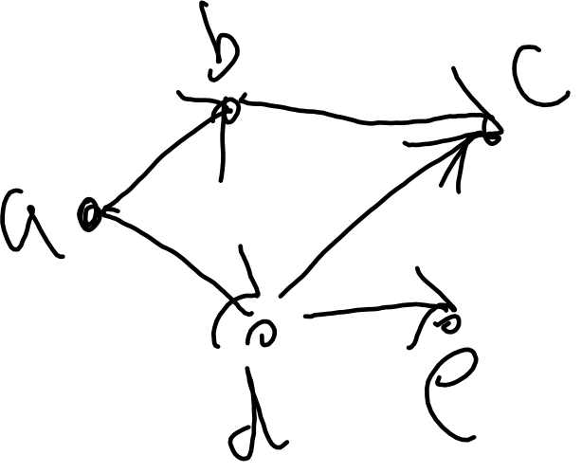
Topological Sort
Defined on a dag.
Dag: Directed Acyclic graph.
A directed graph that has no directed cycles.

Slide 3
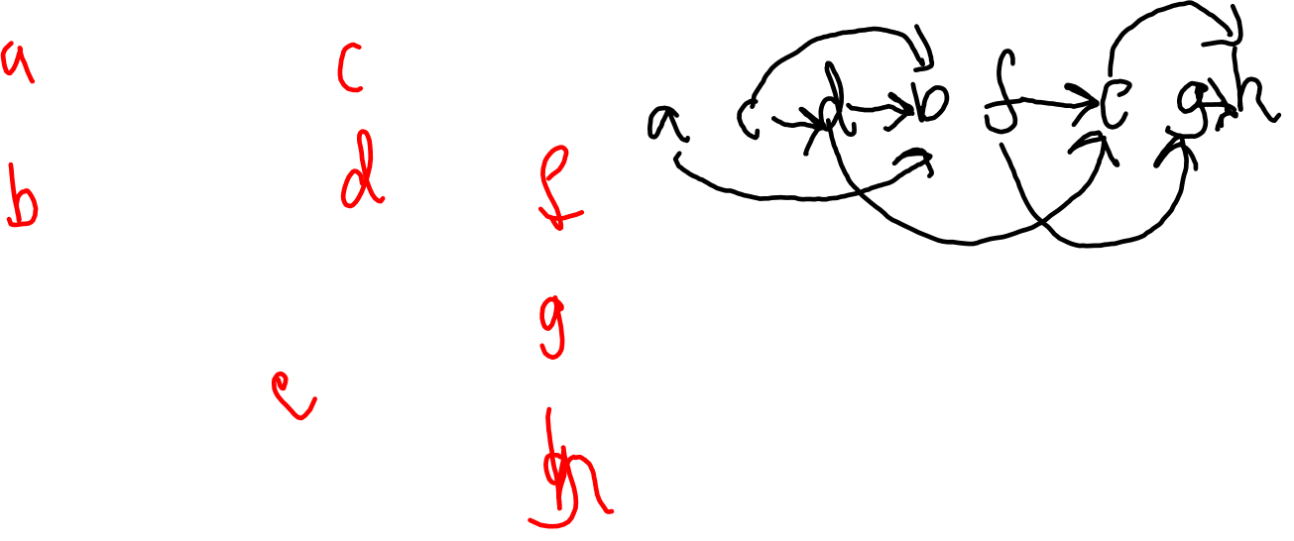
What is Topological Sort?
A list of the vertices of the directed graph.
If there exists an edge (u,v) in the graph, then u occurs before v in the list (the arrows all point to the right)

Slide 4
Topological Sort Algorithm
Call DFS on G to compute finishing times v.f for each vertex v.
Finishing times give the topological order: as each vertex finishes insert them onto a linked list; the list is topologically sorted.

Slide 5
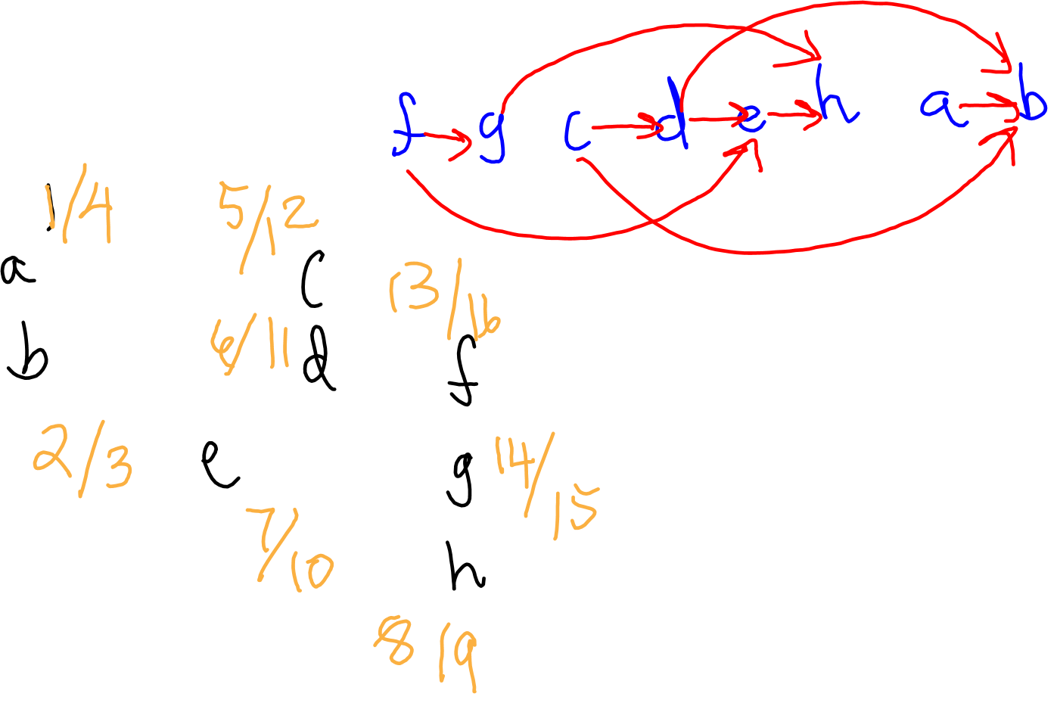
An Example

Slide 6
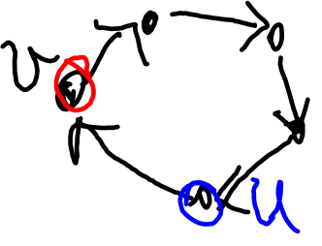
Analysis of Topological Sort
Running time is O(|V|+ |E|) as it is simply a DFS plus a constant number of linked list operations for each vertex.
Correctness:
Lemma: G is acyclic if and only if DFS(G) has no back edges.
Proof: a. If there is a back edge (u, v), the path from v to u and (u, v) form a cycle.
b. If G has a cycle, DFS will yield a back edge due to the white-path theorem:

Slide 7
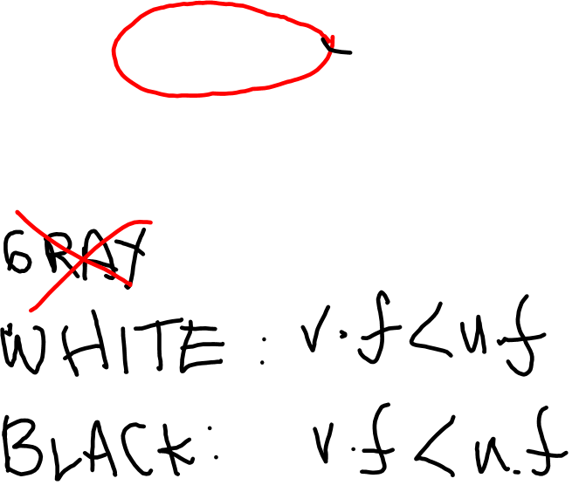
Main Theorem
Topological Sort algorithm is correct: if an edge (u,v) exists in G, v.f < u.f.
Proof: Consider the time that (u,v) is being explored. What color is v?

